Slide 1
Programming Languages
1st – 2nd April 2021
Ms. Farzeen Ashfaq

Slide 2
Math Example
2 + 3 * 7

Slide 3
Math Example
2 + 3 * 7
2 + 21
23

Slide 4
Multiplication
2 + 3 * 7
2 + 7 + 7 + 7
Multiplication is defined as multiple addition
Some rules are defined in terms of other rules
Multiplication is redundant

Slide 5
Rules
What is the minimum subset of rules necessary ?
We can call this minimum subset axioms
Greek axioma “that which is self evident”
We can call derived rules theorems
Greek theorema “a preposition to be proved”

Slide 6
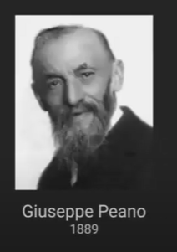
Question
What are axioms for math?
The minimum (non – redundant) set of rules to define all of math.

Slide 7
Peano Axioms
0 is a natural number
x = x
If x = y then y = x
If x = y and y = z then x = z
If b is a natural number and a = b then a is also a natural number
There’s a function S, such that S(n) is a natural number
m = n if and if S(m) = S(n)
There’s no n such that S(n) = 0
If k is a set such that
0 is in k
If n is in K means that S(n) is in K
Then K contains every natural number

Slide 8
Peano Numbers (syntactic sugar)
0
1 := S(0)
2 := S(1) := S(S(0))
3 : = S(S(S(0)))

Slide 9
Syntactic sugar
Convenience rules / symbols that don’t need to be reduced to their most primitive form

Slide 10
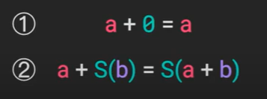
Theorem of Addition
Addition can be thought of as an operation that maps two natural numbers to another natural number
Syntax = a + b

Slide 11
Addition Example
3 + 2
S(S(S(0))) + S(S(0))
S(S(S(S(0))) + S(0))
S(S(S(S(S(0))) + 0))
S(S(S(S(S(0)))))
5

Slide 12
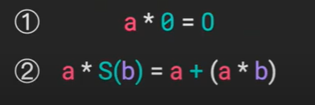
Theorem of Multiplication
Multiplication can also be thought of as an operation that maps two natural numbers to another natural number
Syntax a * b

Slide 13
Axiom Towers
Exponentials
Rational Numbers
Integers (Negative)
Division
Multiplication
Addition
Peaon Axioms

Slide 14
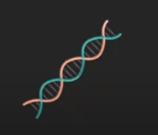
Symbols
It might be tempting to think of symbols as separate from axioms / theorems
In reality symbols don’t mean anything without the rules and the rules only make sense in terms of symbols
0 x 20

Slide 15
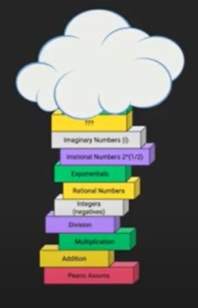
Math is discovered, not invented
Math is the discovery of upper levels in axiom towers that are obscured by clouds
Technically axioms are invented in that they are arbitrary but inventing axioms isn’t what we think about when we think about math.

Slide 16
Recap
Axioms are “self Evident” (taken as given) rules
Theorems are derived (redundant rules)
Axioms and Theorems stack up to build axiom towers
Some symbols are syntactic sugar
Symbols and rules are intrinsically related
Math is the discovery of the consequences of foundational axioms
Axioms are arbitrary but some axiom towers are more useful than others

Slide 17
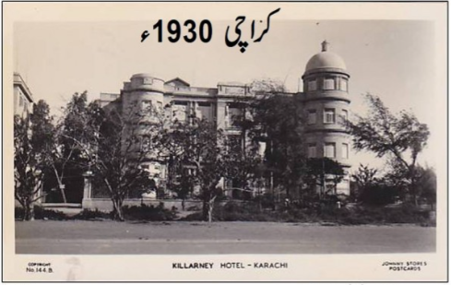
Thinking About Computation

Slide 18
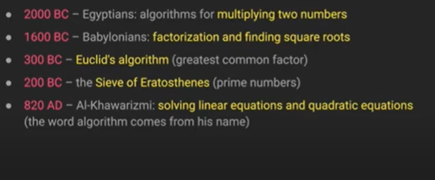
Algorithms already existed in 1930’s

Slide 19
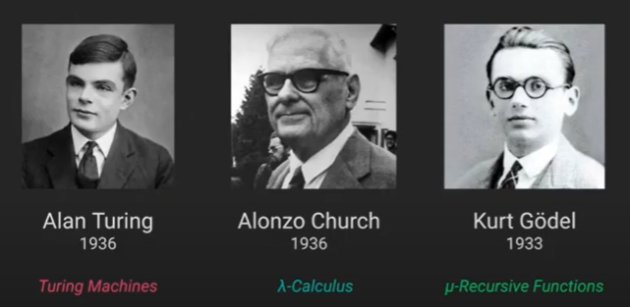
Exactly at the same Time

Slide 20
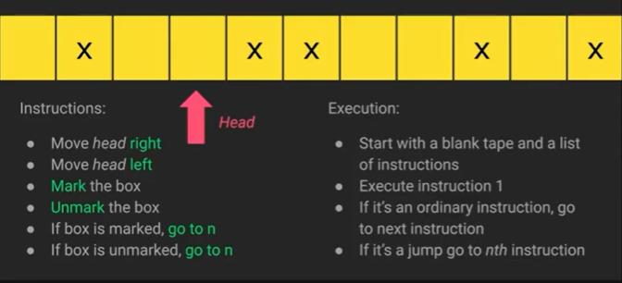
Turing Machines

Slide 21
Turing Created an Axiom Tower for Computing
An algorithm is “computable” if and only if it can be encoded as a Turing Machine
Turing Showed this before the existence of electrical computers
He did this when he was 24 years old
Some Observations
You need an infinite tape and a program.
You are constantly modifying the tape (state)
The tape/state determines how the program runs(jumps)
The behaviour of the program is changed with every tape modification
Reasoning about the behaviour of the program requires understanding of the state of the tape at every moment of modification.

Slide 22
Turing Completeness
You can imagine other axiom towers(e.g. different set of instructions for our Turing machine)
If the axiom tower can simulate a Turing machine, it is describe Turing complete and therefore can compute anything that is computable.

